Slide 1

Integrating the Healthcare Enterprise
XDS
Cross-Enterprise Document Sharing
Integration Profile
Charles Parisot
  IHE IT Technical Committee Co-Chair

Slide 2
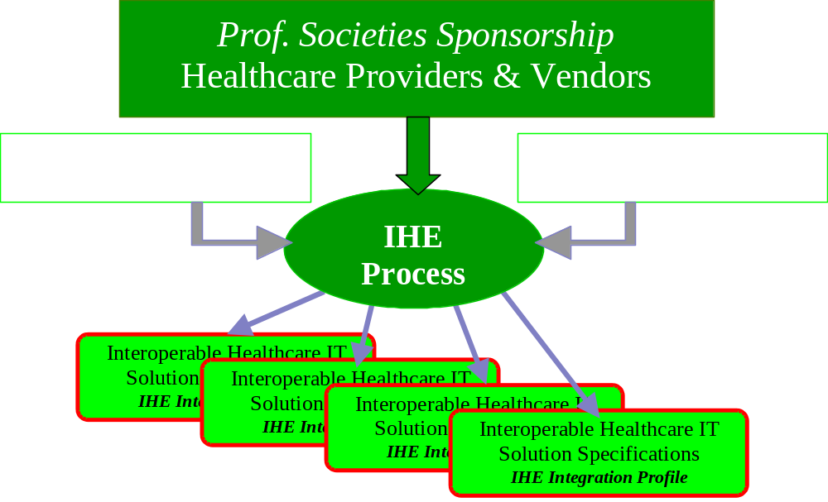
IHE drives healthcare standards based-integration

Slide 3
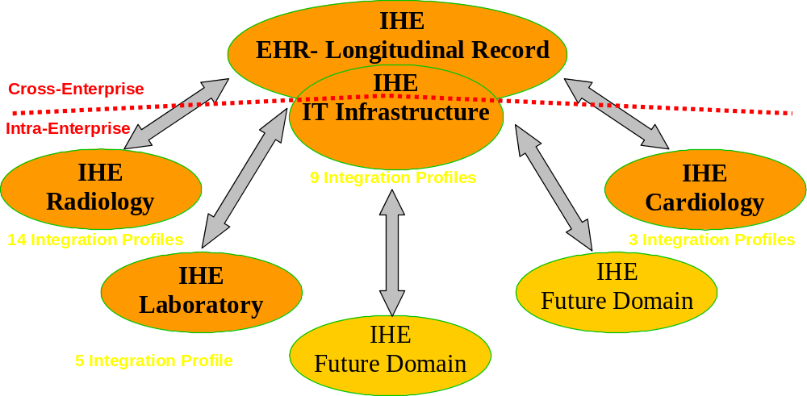
IHE 2004 achievements and expanding scope
Over 80 vendors involved world-wide, 4 Technical Frameworks
31 Integration Profiles, Testing at yearly Connectathons,
Demonstrations at major exhibitions world-wide
Provider-Vendor cooperation to accelerate standards adoption

Slide 4
IHE Process
Users and vendors work together to identify and design solutions for integration problems
Intensive process with annual cycles:
  Identify key healthcare workflows and integration problems
  Research & select standards to specify a solution
  Write, review and publish IHE Technical Framework
  Perform cross-testing at “Connectathon”
  Demonstrations at tradeshows (HIMSS/RSNA…)
Notes:
**Consider making the cycle graphic
Incremental approach: Can’t solve all at once
Connectathon – Practical measure of progress, Validates the integration work accomplished. Refer the Scorecard.
Demo – promotes standards based integration to users/purchasers

Slide 5
A Proven Standards Adoption Process
Product IHE Integration
Statement
IHE Connectathon
Results
IHE
Connectathon
IHE
Demonstration
IHE
Technical
Framework
Product
With IHE
Easy to
Integrate
Products
Standards
IHE
Integration
Profiles B
IHE
Integration
Profile A
User Site
RFP
IHE Integration Profiles at the heart of IHE :
  Detailed selection of standards and options each solving a specific integration problem
  A growing set of effective provider/vendor agreed solutions
  Vendors can implement with ROI
  Providers can deploy with stability

Slide 6
More on IHE IT Infrastructure
To learn more about IHE IT Infrastructure
Integrating the Healthcare Enterprise:
www.himss.org/ihe
Read the IHE Brochure
http://www.himss.org/content/files/IHE_newsletter_final.pdf

Slide 7
Introduction:
EHR Cross-Enterprise
Clinical Document Sharing
First step towards the longitudinal dimension of the EHR:
Focus: Clinical Information Exchange between EHRs in care settings to communicate with a distributed longitudinal EHR.
Goal: Meet a broad range of EHR-LR (Longitudinal Record) needs with a distributed,
cross-enterprise,
document centric
infrastructure

Slide 8
Continuity of Care:
Patient Longitudinal Record
Nursing Homes
Acute Care
(Inpatient)
Other Specialized Care
(incl. Diagnostics Services)
GPs and Clinics
(Outpatient)
Typically, a patient goes through a sequence of encounters
in different Care Setting

Slide 9





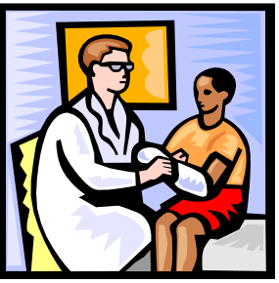
Sharing records that have been published
community
Laboratory Results
Specialist Record
Hospital Record
Reference
to records
Patient data presented to Physician
Records
Returned
Clinical IT System
Index of patients records
(Document-level)
Sharing System
Temporary Aggregate
Patient History
Patient Authorized Inquiry
Reference
to Records for Inquiry
Clinical Encounter

Slide 10
Cross-enterprise Document Sharing
Documents Registry
EHR-LR:
Longitudinal Record
as used
across-encounters
Long-Term Care
Documents
Repository
Acute Care
(Inpatient)
Other Specialized Care
or Diagnostics Services
PCPs and Clinics
(Outpatient)
EHR-CR: Care Record systems
supporting care delivery

Slide 11
Cross-enterprise Document Sharing
EHR-LR:
Longitudinal Record
as used
across-encounters
EHR-CR
Long-Term Care
EHR-CR
EHR-LR
Acute Care
(Inpatient)
EHR-CR
Other Specialized Care
or Diagnostics Services
EHR-CR
PCPs and Clinics
(Outpatient)
EHR-CR: Care Record systems
supporting care delivery

Slide 12
EHR Cross-Enterprise Document Sharing
Distributed: Each Care delivery organization “publishes” clinical information for others. Actual documents may remain in the source EHR-CR.
Cross-Enterprise: A Registry provides an index for published information to authorized care delivery organizations belonging to the same clinical affinity domain (e.g. an LHII).
Document Centric: Published clinical data (clinically attested) is organized into “clinical documents”. Allows each clinical affinity domain to manage, through agreed standard document types, the broad space of clinical information and associated coded vocabularies (HL7-CDA, ASTM-CCR, PDF, DICOM, etc.).
Document Content Generic: Entries into the Document Registry contain standardized attributes to ensure deterministic document searches. Document content is processed only by source and consumer IT systems).

Slide 13
EHR Cross-Enterprise Document Sharing
What does IHE delivers ?
A well-defined set of practical scenarios: A IHE Integration Profile is a standards-based solution so that all the IT systems that need to cooperate will seamlessly integrate when performing these scenarios.
A definition of the Actors involved: In IHE Integration Profiles an Actor represents a function that need to be performed by one of the IT systems involved.
A complete specification of the Transactions involved : In IHE Integration Profiles, a Transaction is an IHE specified exchange of one or more standards-based messages. IHE integrates by reference the most appropriate standard(s) (e.g. HL7, ebXML, W3C, etc.) and resolves any options to ensure interoperability.

Slide 14
Cardiac Care Scenario (1)
Folder
PCP
Submission
Set
1
XDS
Document
Cardiac
Assessment
Cardiologist
3
Laboratory
2
4
Radiology

Slide 15
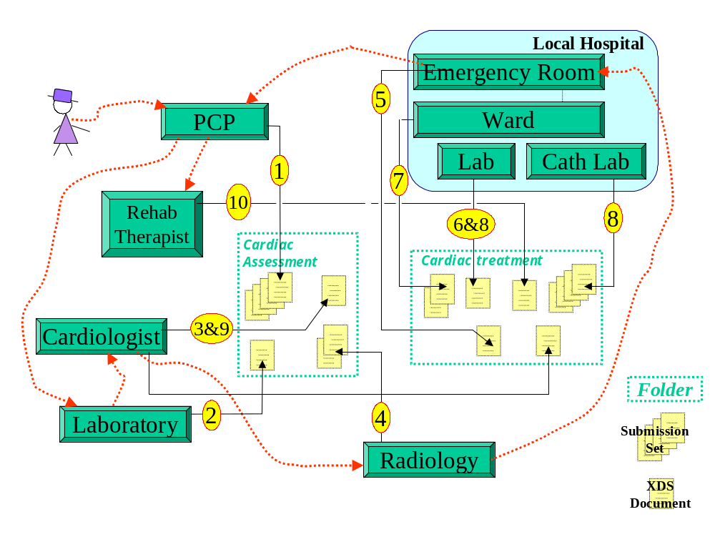
Cardiac Care Scenario (2)

Slide 16
Standards selection for IHE XDS
Best of breed for an interoperable solution
Electronic Business
Standards
ebXML, SOAP, etc.
Internet Standards
HTML, HTTP,
ISO, PDF, JPEG, etc.
Healthcare
Content Standards
HL7 CDA, CEN EHRcom
HL7 V2/V3, ASTM CCR
DICOM, etc.
No single standard can address Cross-enterprise Document Sharing: Marriage of healthcare standards facilitates implementation and leverages complementary technologies (e.g. security & privacy).
➔ Solution driven and pragmatic selection is IHE’s strength.

Slide 17
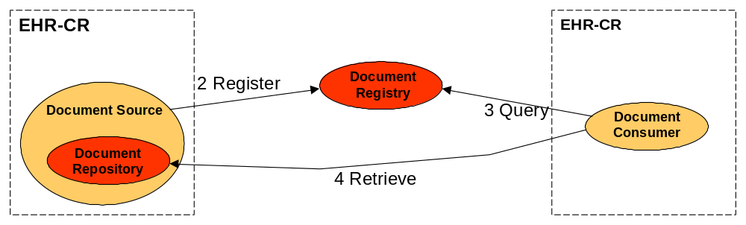
Integration Model 1:
EHR-CR with Repository at Source
An EHR-CR completes a phase of care for a patient where it:
  Has these documents available as Repository Actor.
  Registers documents with a Registry actor.
Any other EHR-CR may query the Registry actor, find out about documents related to all phases of care for the patient and chose to retrieve some of these documents from any Document Repository Actor (Used in model 1 & 2).

Slide 18
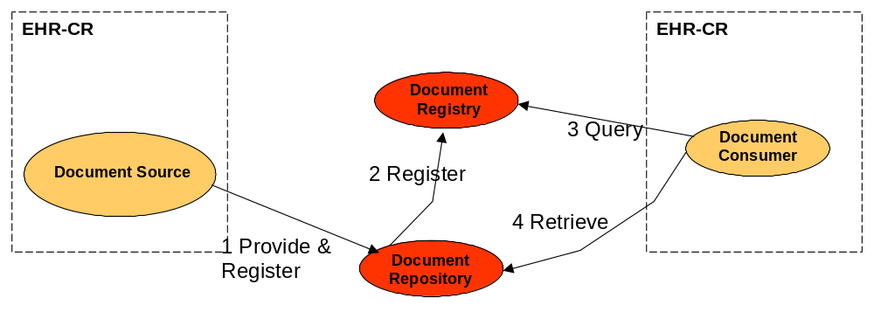
Integration Model 2:
EHR-LR with Third Party Repository
An EHR-CR completes a phase of care for a patient where it:
  Provides the documents to a Repository Actor of its choice.
  Documents are Registered with a Registry Actor.
Any other EHR-CR may query the Registry Actor, find out about documents related to all phases of care for the patient and chose to retrieve some of these documents from any Repository Actor (Used in model 1 & 2).

Slide 19
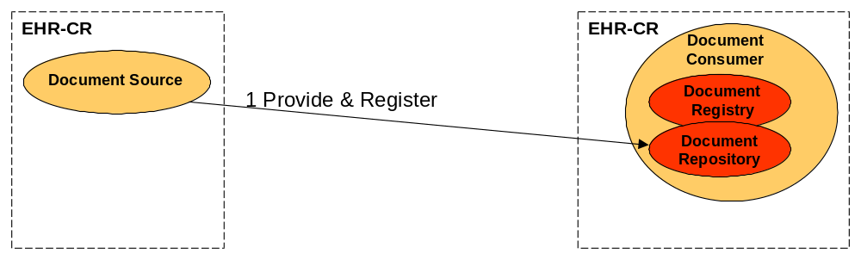
Integration Model 3:
Direct Patient Transfer-Referral
An EHR-CR completes a phase of care for a patient where it:
  Provides and Registers a set of documents to a Document Repository in an EHR-CR (newly created documents and priors of interest documents).
The EHR-CR Consumer Actor has the documents and may respond to queries and provide them to other document consumers.

Slide 20
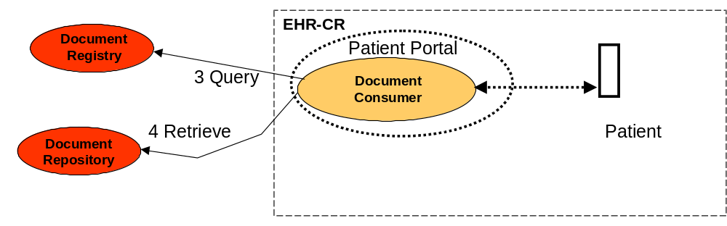
Integration Model 4:
Direct Patient Access
A patient accesses own record :
  Query and Retrieve a set of documents using for example a portal application that offers the ability to display documents’ content.
This a particular case of an EHR-CR, where the patient is interested by its own care. Patient may also register and provide documents (portal as document source not shown below).

Slide 21
Integrating the Healthcare Enterprise
XDS
Cross-Enterprise Document Sharing
Integration Profile
A more detailed presentation

Slide 22
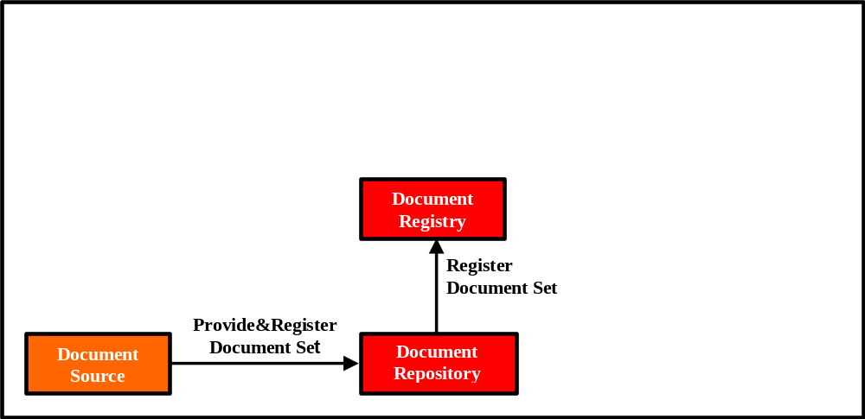
XDS Actors and Transactions

Slide 23
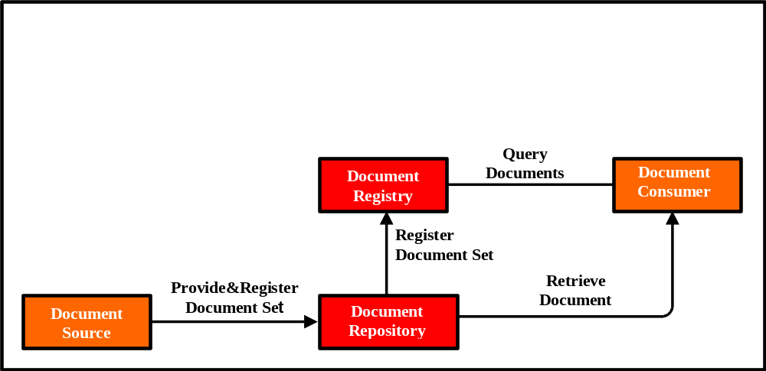
XDS Actors and Transactions

Slide 24
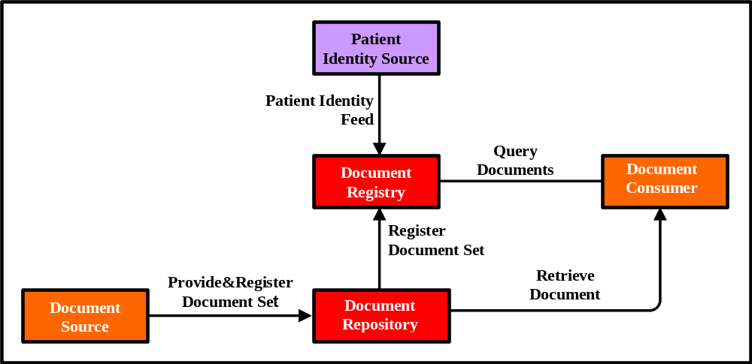
XDS Actors and Transactions

Slide 25
XDS IHE Integration Profile:
Actors (Application Roles)
Document Source (EHR-CR)
Healthcare point of service system where care is provided and associated clinical information is first collected
Document Registry (EHR-LR)
Index and metadata database for all published clinical documents that may be queried.
Document Repository (EHR-LR)
Maintains and stores published documents that may be retrieved
Document Consumer (EHR-CR)
Healthcare point of service application system where care is provided that needs access to documents and information
Patient Identity Source (EHR-LR)
Assigns and managed Patient identifiers for the XDS Sharing Domain

Slide 26
XDS IHE Integration Profile:
Key Concepts
XDS Document
XDS Submission Set
XDS Folder
XDS Submission Request
XDS Affinity Domain
Patient Identification
Document Lifecycle

Slide 27
XDS Document
The smallest unit of information that may be provided to a Document Repository Actor and be registered as an entry in the Document Registry Actor.
An XDS Document contains observations and services for the purpose of exchange with: Persistence, Stewardship, Potential for Authentication, and Wholeness (See HL7 Clinical Document Architecture Release 1).
An XDS Document must be human and/or application readable. It shall comply with a published standard defining its structure, content and encoding. IHE intends to define content-oriented Integration Profiles to be used in conjunction with XDS.
An XDS Document shall be associated with Meta-Data defined by the Document Source. This Meta-Data information is managed by the Document Registry Actor, and is used for query purposes by Document Consumer Actors.
An XDS Document shall be provided to the Document Repository Actor as an octet stream (with MIME type) to be retrieved unchanged.
Notes:
The EHR-LR (Longitudinal Record) brings together patient encounter information managed by multiple care delivery systems, ranging from EHR-CR (Care-delivery Record) in a large hospital network to small physician practice management systems.
EHR-LR will be cross-enterprise, possibly across large geographical regions, and may include one or more clinical domains.
EHR-LR will be typically collected and retained over a large period of time, providing a deep historic record for the patient.
EHR-LR is supported by repositories of encounter data that contribute to the patient’s longitudinal healthcare record.
EHR-LR data will be found in multiple repositories that will interoperate and provide a seamless historical view of the patient.
Encounter data will very likely include some clinical documents, state and workflow information that will not be stored in the EHR-LR.

Slide 28
XDS Submission Set
Created by a single Document Source
Issued by a single Provide & Register Document Set or Register Document Set transaction
Related to care event(s) of a single uniquely identified patient.
Makes a record of all new documents or references to previously submitted documents.
The XDS Submission Set is labelled by the Document Source with a code (e.g. clinical meaning).
It should be possible to query the EHR-LR Registry and find all documents registered in the same XDS Submission Set.
Notes:
The EHR-LR (Longitudinal Record) brings together patient encounter information managed by multiple care delivery systems, ranging from EHR-CR (Care-delivery Record) in a large hospital network to small physician practice management systems.
EHR-LR will be cross-enterprise, possibly across large geographical regions, and may include one or more clinical domains.
EHR-LR will be typically collected and retained over a large period of time, providing a deep historic record for the patient.
EHR-LR is supported by repositories of encounter data that contribute to the patient’s longitudinal healthcare record.
EHR-LR data will be found in multiple repositories that will interoperate and provide a seamless historical view of the patient.
Encounter data will very likely include some clinical documents, state and workflow information that will not be stored in the EHR-LR.

Slide 29

Example
A Document Source prepares a Submission Set with two new Documents
Submission
Set
1
Objects to be Registered
Document
Entry
Document
Entry
Objects to be stored in the Repository
Document
Document

Slide 30
Document Repository and Registry – First Submission
Document Registry
Submission Request
Folder A
Submission
Set
1
Document
Entry
Document
Entry
Document
Document
Document Repository
Document Repository

Slide 31
XDS Folder
A means to group one or more document (new or existing) for any reason: emergency information, a visit, an episode of care, or various approaches to define and identify the phase of care or service to which documents pertain (not ruled by XDS).
Folder shall group documents related to a single patient.
A Folder may include contributions from one or more Document Sources.
New documents or reference to existing documents may be added at anytime to a Folder by Document Source Actors.
Will be permanently known by the registry. It should be possible to query the Document Registry and find all documents registered in the same Folder.
Notes:
The EHR-LR (Longitudinal Record) brings together patient encounter information managed by multiple care delivery systems, ranging from EHR-CR (Care-delivery Record) in a large hospital network to small physician practice management systems.
EHR-LR will be cross-enterprise, possibly across large geographical regions, and may include one or more clinical domains.
EHR-LR will be typically collected and retained over a large period of time, providing a deep historic record for the patient.
EHR-LR is supported by repositories of encounter data that contribute to the patient’s longitudinal healthcare record.
EHR-LR data will be found in multiple repositories that will interoperate and provide a seamless historical view of the patient.
Encounter data will very likely include some clinical documents, state and workflow information that will not be stored in the EHR-LR.

Slide 32
XDS Submission Request
An XDS Submission Request is created by a single Document Source through a single Provide & Register Document Set transaction Issued.
It includes:
  one and only one Submission Set
  One or more new documents and zero or more references to existing documents included in the Submission Set
  Inclusions of new or references to existing documents into new and existing Folders.
Upon successful submission all (or none) of the objects it includes are available for sharing.
XDS Folder are labeled by the Document Source(s) with an associated code (e.g. clinical meaning)
Notes:
The EHR-LR (Longitudinal Record) brings together patient encounter information managed by multiple care delivery systems, ranging from EHR-CR (Care-delivery Record) in a large hospital network to small physician practice management systems.
EHR-LR will be cross-enterprise, possibly across large geographical regions, and may include one or more clinical domains.
EHR-LR will be typically collected and retained over a large period of time, providing a deep historic record for the patient.
EHR-LR is supported by repositories of encounter data that contribute to the patient’s longitudinal healthcare record.
EHR-LR data will be found in multiple repositories that will interoperate and provide a seamless historical view of the patient.
Encounter data will very likely include some clinical documents, state and workflow information that will not be stored in the EHR-LR.

Slide 33
Document Repository and Registry – Initial State
Document Registry
Folder A
Submission
Set
1
Document
Entry
Document
Entry
Document
Document
Document Repository
Document Repository

Slide 34
Submission Set 2 - Logical Content
Submission
Set
2
Original
Document
Entry
By
Reference
Document
Entry
Document
Entry
Document
Document
Document

Slide 35
Document Repository and Registry – Submission Request
Document Registry
Submission Request
Folder A
Folder B
Submission
Set
1
Submission
Set
2
Document
Entry
Document
Entry
Document
Entry
Document
Entry
Document
Document
Document
Document
Document Repository
Document Repository

Slide 36
Document Repository and Registry – Final State
Document Registry
Folder A
Folder B
Submission
Set
1
Submission
Set
2
Document
Entry
Document
Entry
Document
Entry
Document
Entry
Document
Document
Document
Document
Document Repository
Document Repository

Slide 37
XDS Affinity Domain
A Clinical Affinity Domain is made of a well defined set of Document Repositories, Document Sources and Consumers that have agreed to share clinical documents registered into a single Document Registry.
Addition of a Document Repository or Document Consumer or Source Actor is an administrative act that requires awareness from the Registry and Repositories.
A Clinical Affinity Domain does not deliver care. Only the EHR-CRs belonging to a Clinical Affinity Domain do.
There is a chain of trust established between the users (healthcare staff) in each EHR-CRs and the Clinical Affinity Domain.
It has a patient identification management policy which requires all Document Sources/Consumers to share the same Patient Identifier Registration Domain
A Clinical Affinity Domain may choose to rule what type of documents and vocabularies are used in the documents content.
Notes:
The EHR-LR (Longitudinal Record) brings together patient encounter information managed by multiple care delivery systems, ranging from EHR-CR (Care-delivery Record) in a large hospital network to small physician practice management systems.
EHR-LR will be cross-enterprise, possibly across large geographical regions, and may include one or more clinical domains.
EHR-LR will be typically collected and retained over a large period of time, providing a deep historic record for the patient.
EHR-LR is supported by repositories of encounter data that contribute to the patient’s longitudinal healthcare record.
EHR-LR data will be found in multiple repositories that will interoperate and provide a seamless historical view of the patient.
Encounter data will very likely include some clinical documents, state and workflow information that will not be stored in the EHR-LR.

Slide 38
Patient Identification Mgt - Local X-ref
Patient Identity Source
Patient Identity Feed
Dm=XAD, Pid=Px
Patient Identification Domain C
Patient Identification Domain XAD
XDS Document Registry
Patient Identification Domain D2
Document
Entry
XDS Document Consumer
XDS Document Source
Query Docs
Dm=XAD
Pid=Px
Dm=XAD
Pid=Px
Dm=XAD
Pid=Px
Provide&Register Doc Set
Dm=D2
Pid=Pd
Dm=C
Pid=Pc
XDS Doc
XDS Doc
XDS
Document Repository

Slide 39
Patient Identification Mgt - PIX X-ref
Patient Identity Source
Patient Identity Feed
Dm=XAD, Pid=Px
Patient Identity X-Ref Mgr
Patient Identity X-Ref Mgr
Patient Identification Domain C
Patient Identification Domain XAD
XDS Document Registry
Patient Identification Domain D2
Document
Entry
XDS Document Consumer
XDS Document Source
Query Docs
Dm=XAD
Pid=Px
Dm=XAD
Pid=Px
Patient ID
Consumer
Dm=XAD
Pid=Px
Provide&Register Doc Set
Dm=D2
Pid=Pd
Dm=C
Pid=Pc
XDS Doc
Patient ID
Consumer
XDS Doc
XDS
Document Repository

Slide 40
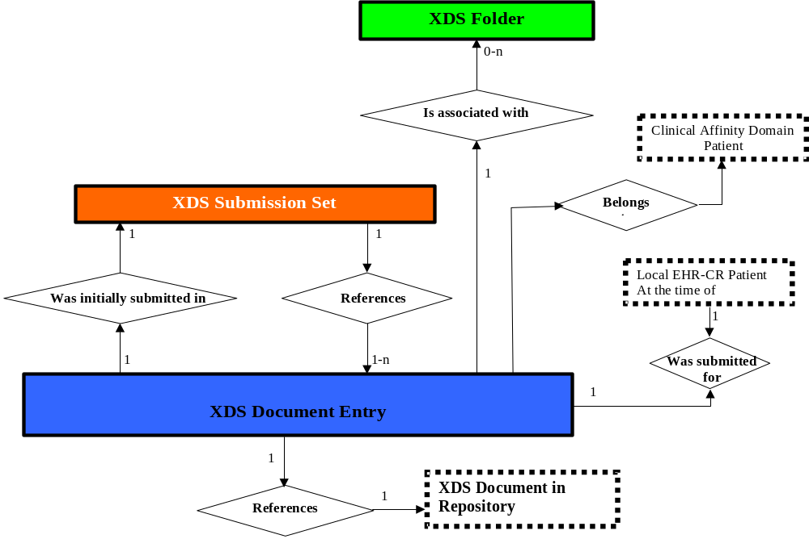
XDS Query Model (1)
ebXML Query: SQL with ebRIM XML returned

Slide 41
XDS Query Principles (2)
Query Filtering Keys: Against a standardized set of “document attributes” to ensure deterministic searches:
  Patient Id (care target for document)
  Document Type
  Service Time (Start & Stop Time)
  Event Code where document was produced
  Organization/Provider Involved
Query Filtering Keys: Against a standardized set of submission set/Folder attributes to ensure deterministic searches:
  Submission Set Id and Code.
  Submission activity begin & end date/time
  Folder Id and List of Codes
  Folder activity begin & end date/time

Slide 42
Querying for Documents
Patient Id
The four main axis for Document Queries:
Which Patient ?
What Type of Document ?
3 interrelated sub-dimensions:
Facility Type
Document Type
Event Type
By Groups of Documents
By time of Services
15 additional attributes to query.
Folder
Facility Type
Document Type
Event Type
Submission
Set
Time of Services
XDS core Meta-Data derived from HL7 CDA and CEN EHRcom

Slide 43
XDS - Cross-Enterprise Document Sharing
Basic Transactions provided by ebXML Registry Services, ebXML Registry Information Model, ebXML Messaging Services (OASIS-compatible with HL7 V3 messaging layer).
Document Meta-Data (CDA Header+EHRcom Composition) managed by ebXML registry Objects.
Document Lifecycle (Medical Records/CDA based) for (addendum, replacement, deprecate, etc.) as mapped to ebXML Registry Information Model.
Shall be used in conjunction with any standard content, e.g. ASTM Continuity of Care Record), EHRcom Compositions, HL7 Clinical Document Architecture and others such as DICOM, PDF, etc.

Slide 44
ebXML and XDS
XDS Adapter
Patient Id is known
Vocabularies Checking
Submission Set to approve if registration OK otherwise,
roll-back registration
Patient Identifier
Source
Patient Id
Feed
Document Registry
ebXML Registry
ebXML Compliance:
All transaction are valid ebXML transactions
Sequencing may be simplified
ebXML query against a valid but specialized Registry information model
XDS Registry
Adapter
Query
Document
Register
Document Set
Document
Source
Document
Repository
Document
Consumer
Provide & Register
Document Set

Slide 45
Conclusion:
IHE Cross-Enterprise Document Sharing
IHE XDS addresses one of the key integration problems in the realization of the EHR vision.
IHE does not claim with XDS to address all aspects of a complete and interoperable EHR System.
In collaboration with well established standards bodies (HL7, ASTM, CEN, OASIS, IETF, DICOM, etc.) and other EHR related initiatives world-wide (EuroREC, etc.),
IHE expects to contribute at a more cost-effective and rapid deployment of community, regional and national health IT infrastructures.

Slide 46
More information….
Web sites: www.himss.org/ihe
        www.rsna.org/ihe
        www.ihe-europe.org
  IHE IT Infrastructure Technical Framework for 2003-2004 - V 1.0 Final Text
  IHE IT Infrastructure Technical Framework Supplements for 2004-2005 – Public Comments
  Comments at http://forums.rsna.org, IHE forum,
  IT Infrastructure sub-forum, until July 15th, 2004.
Non-Technical Brochures :
  IHE Brochure, IHE Fact Sheet
  IHE Connectathon Results
  IHE Products Integration Statements

